Slide 1
CAR PRICE PREDICTION

Slide 2
Use Cases
ML can cope with price volatility
ML models can analyze multiple data sources at once
ML improves the accuracy of price predictions
ML reduce manual efforts
ML can help you improve your profit margin

Slide 3
Dataset
Dataset includes below columns
Name
Company
Year
Price
Kms_driven
Fuel Type

Slide 4
EDA
Exploratory Data Analysis (EDA) is an approach to analyze the data using visual techniques. It is used to discover trends, patterns, or to check assumptions with the help of statistical summary and graphical representations

Slide 5
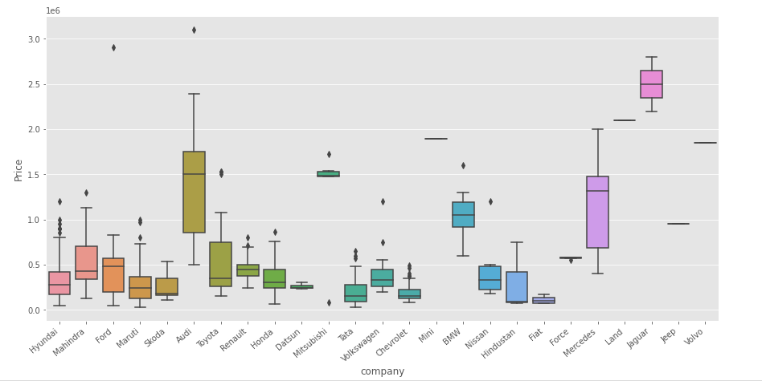
1. Checking relationship of Company with Price

Slide 6
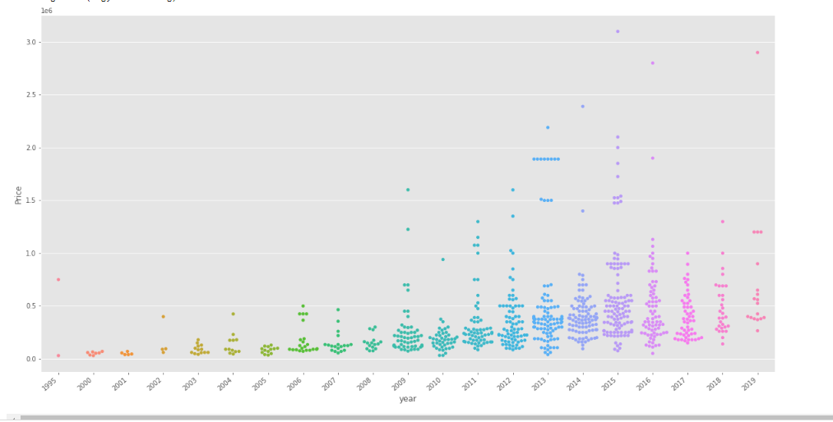
2. Checking relationship of Year with Price

Slide 7
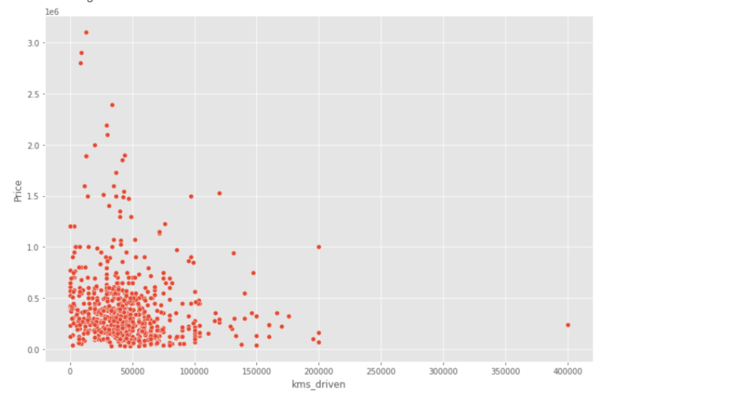
3. Checking relationship of kms_driven with Price

Slide 8
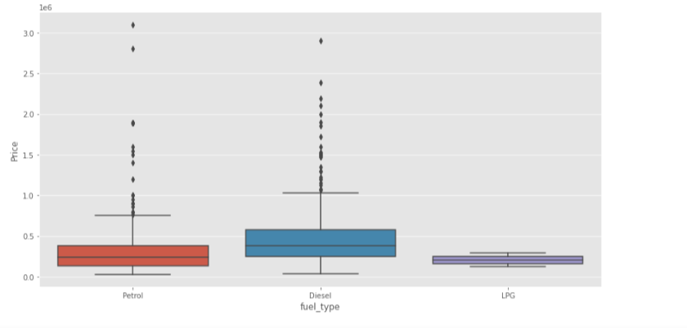
4. Checking relationship of Fuel Type with Price

Slide 9
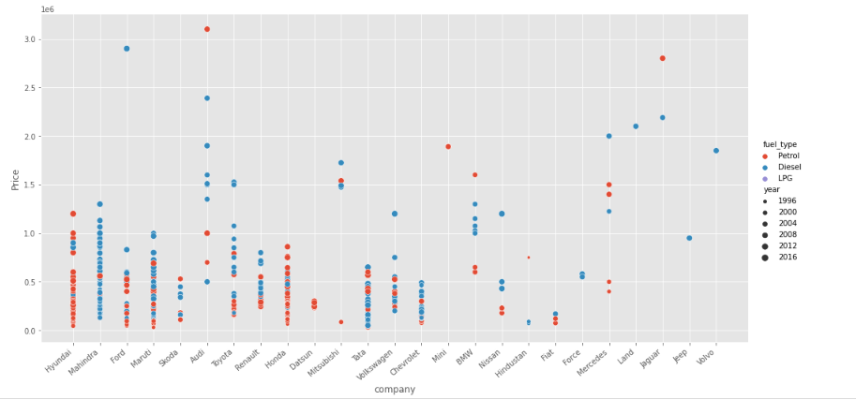
5. Relationship of Price with FuelType, Year and Company mixed

Slide 10
Model
Linear Regression was chosen as the model due to its simplicity and comparatively small training time. The features, without any feature mapping, were used directly as the feature vectors.

Slide 11
Conclusion
Car price prediction can be a challenging task due to the high number of attributes that should be considered for the accurate prediction. The major step in the prediction process is collection and preprocessing of the data. Data cleaning is one of the processes that increases prediction performance, yet insufficient for the cases of complex data sets as the one in this research. Therefore, there is an urgent need for a Car Price Prediction system which effectively determines the worthiness of the car using a variety of features. The proposed system will help to determine the accurate price of used car price prediction.

